Slide 1
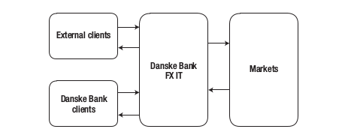
FX IT System
Conway’s Law:
"organizations which design systems ... are constrained to produce designs which are copies of the communication structures of these organizations."
— M. Conway
Conway, Melvin E. (April 1968), "How do Committees Invent?"
Bucchiarone, Dragoni, Dustdar, Larsen, Mazzara (2018). From Monolithic to Microservices, An Experience Report from the Banking Domain. IEEE Software, May/June 2018. pp. 51
Based on this quote being featured in the article, perhaps we can assume that the architecture of the FX Monolithic Architecture was similar to its communication structures.

Slide 2
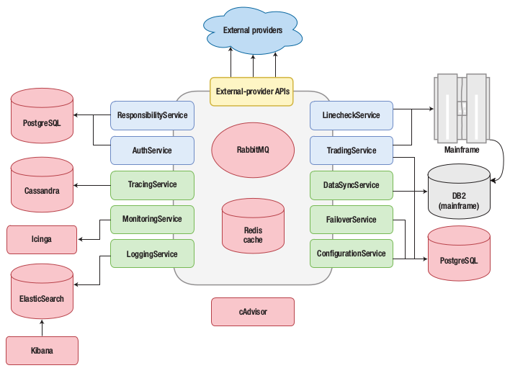
FX Microservice Architecture
Bucchiarone, Dragoni, Dustdar, Larsen, Mazzara (2018). From Monolithic to Microservices, An Experience Report from the Banking Domain. IEEE Software, May/June 2018. pp. 52

Slide 3
FX Microservice Architecture
RabbitMQ
RabbitMQ is a message broker that works to pass messages to/from services.
The message queue receives messages from the internal services, as well as from the external APIs. These messages carry requests.
The Message Queue stores messages and sends them to the recipient service.

Slide 4
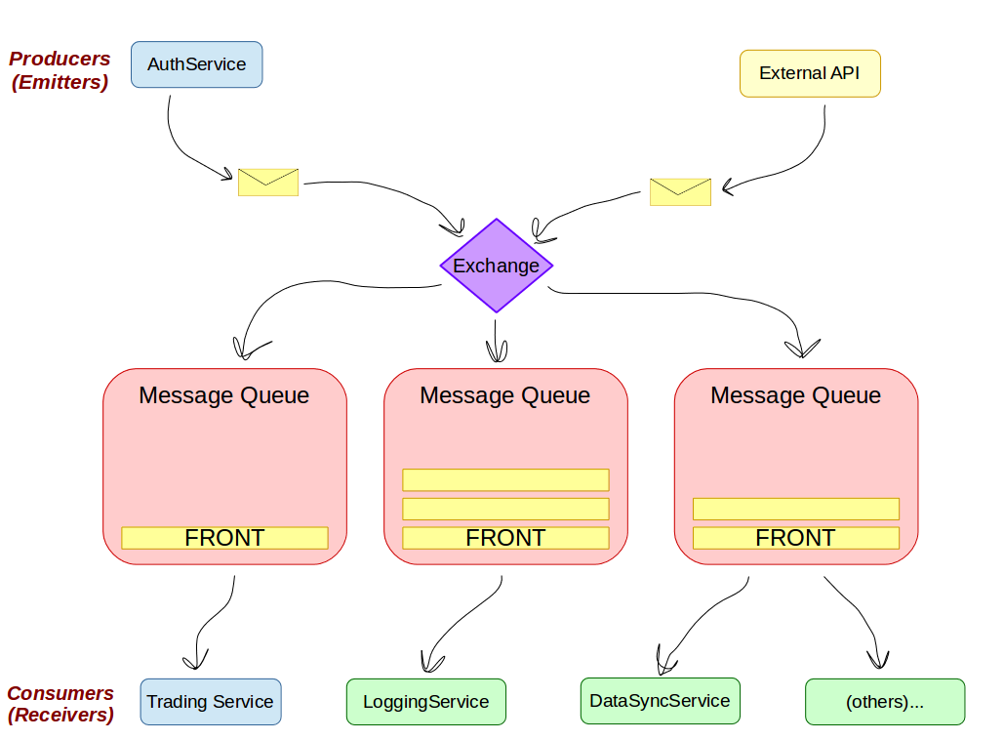

Producers
(Emitters)
AuthService
External API
Exchange
Message Queue
Message Queue
Message Queue
FRONT
FRONT
FRONT
Consumers
(Receivers)
Trading Service
LoggingService
DataSyncService
(others)...
Notes:
Multiple queues are used
Perhaps think of message passing as one service making a “function call” to another, but indirectly.

Slide 5
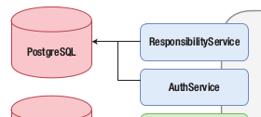
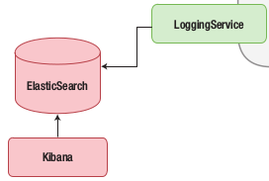
FX Microservice Architecture
Each service has its own responsibility, and has its own system setup.
Different services may use different databases may be implemented in different programming languages.
And by being independent, services don’t have to wait on shared resources to get their work done.
Bucchiarone, Dragoni, Dustdar, Larsen, Mazzara (2018). From Monolithic to Microservices, An Experience Report from the Banking Domain. IEEE Software, May/June 2018. pp. 52

Slide 6
FX Microservice Architecture
Linecheck Service
For an example, the Logging service is probably in heavy use – all services probaby log their activity.
By using RabbitMQ, which guarantees delivery, a service can send off a “logging” message and continue on with its work.
In a Monolithic architecture, the logging process would take up resources, and if the system weren’t multithreaded, all processing might halt until logs were written each time.
Responsibility Service
Auth Service
Trading Service
Logging Service
Data Sync Service
Tracing Service
Monitoring Service
Fallover Service
Configuration Service
External APIs

